Slide 1
Particle Image Velocimetry of Collapsing Toroidal Droplets
Eric Berger
Ekapop Pairam
Dr. Phil Segre (Oxford College)

Slide 2
What is PIV?
Particle Image Velocimetry (PIV) involves monitoring the position and movement of tracer particles, and creating corresponding vector fields.
These vector fields can accurately describe the position, velocity, and vorticity of a medium.

Slide 3
The PIV Process
Create a solution/medium containing tracer particles.
Subject the suspension to the desired experiment.
Take a stop-motion video of the liquid during the experiment.
Analyze the video frames using PIV software.
Generate corresponding vector fields.

Slide 4
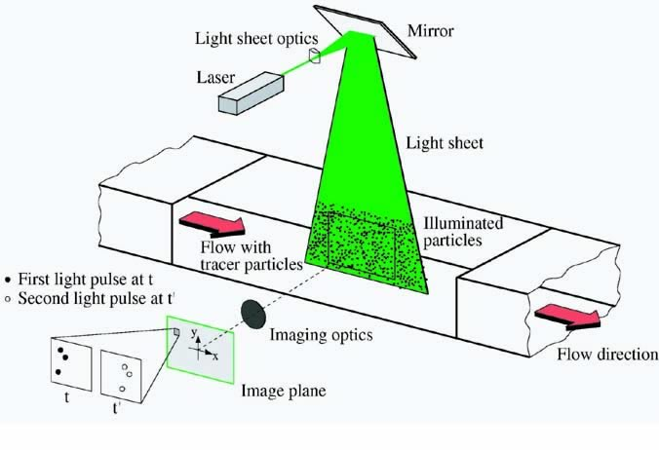
A Typical PIV Set-Up
PIV/LDV MEASUREMENTS OF MEAN VELOCITY AND TURBULENCE IN A COMPLEX OPEN CHANNEL FLOW, B-S. Hyun, R. Balachandar, K. Yu, and V.C. Patel.
<http://www.personal.psu.edu/bvd5010/blogs/portfolio/2010/06/aerospace-engineering.html>

Slide 5
OpenPIV
OpenPIV is a free, MATLAB-coded, PIV analysis program that compares small boxes in each successive frame of a video, and assigns displacement vectors based on how the objects within the small boxes move.
A sample, raw vector field rendered by OpenPIV, from a video of a dotted piece of paper sliding downward.
Taylor, Z.J.; Gurka, R.; Kopp, G.A.; Liberzon, A.; , "Long-Duration Time-Resolved PIV to Study Unsteady Aerodynamics," Instrumentation and Measurement, IEEE Transactions on , vol.59, no.12, pp.3262-3269, Dec. 2010 doi: 10.1109/TIM.2010.2047149 URL: http://ieeexplore.ieee.org/stamp/stamp.jsp?tp=&arnumber=5464317&isnumber=5609237

Slide 6
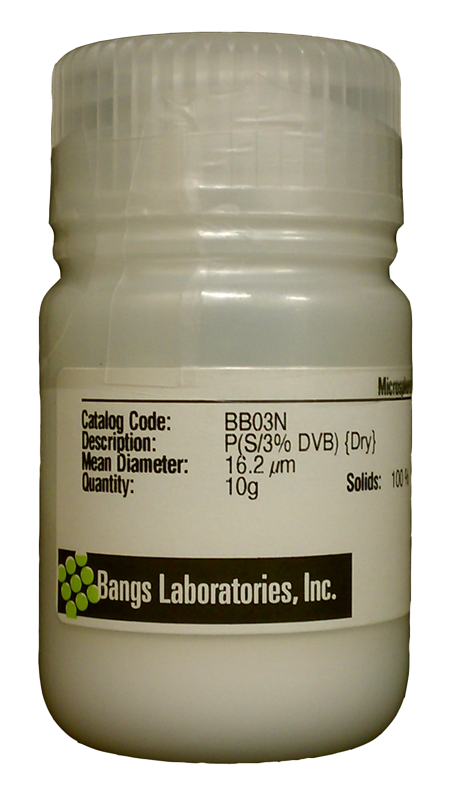
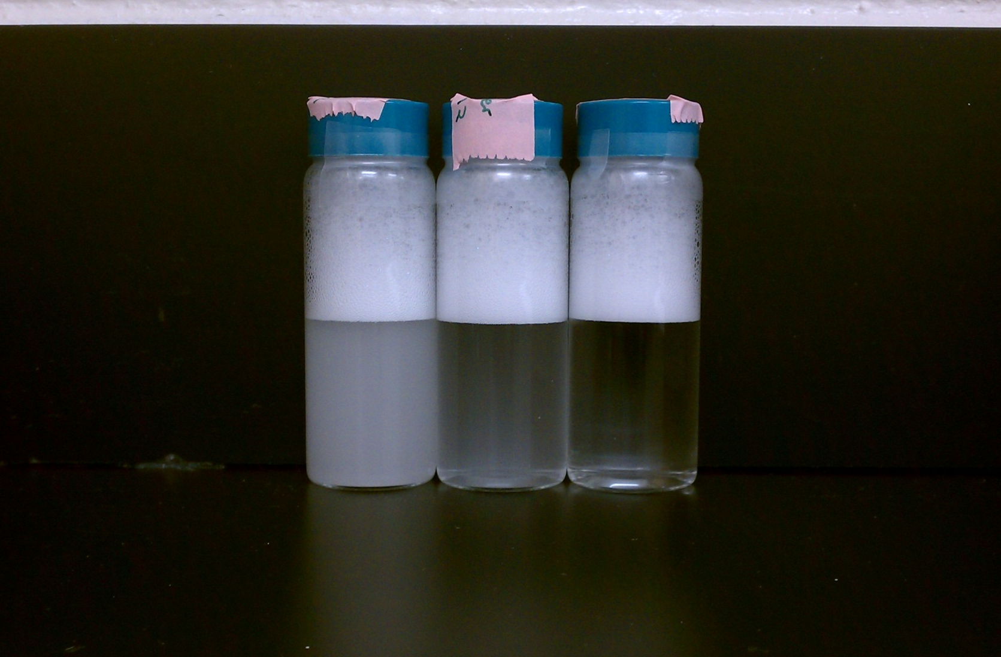
Our Microbead Suspensions
The suspensions for our experiment consist of 15μm microbeads suspended in 60mM SDS water. Note the difference in color between the 1,500,000 ppg (left), 150,000 ppg (center), and 15,000 ppg (right) samples. The bubbles appear as a result of shaking, due to the presence of SDS. The particles used are depicted in their container on the far left.

Slide 7
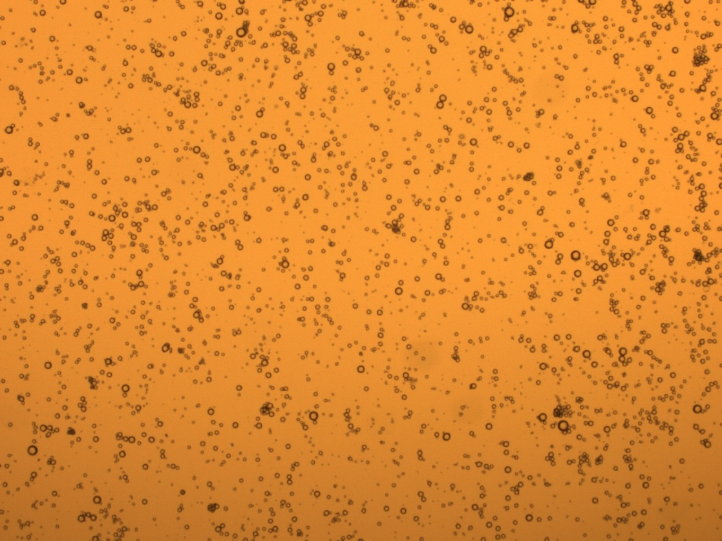
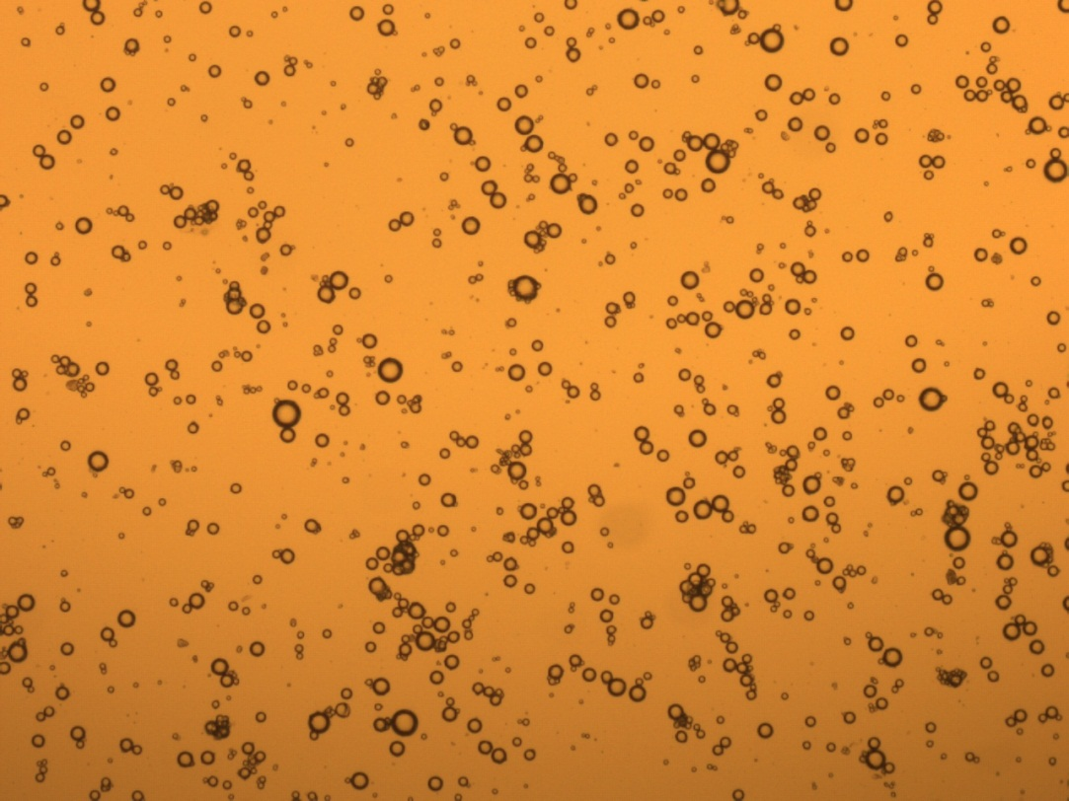
Below is a microscope image of the 1,500,000 ppg microbead sample as it appears under a 5x lens.
Above is a microscope image of the 1,500,000 ppg microbead sample as it appears under a 2.5x lens.

Slide 8
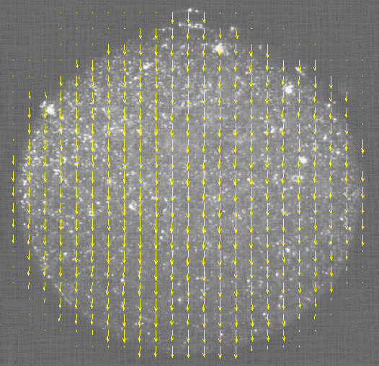
Testing Our PIV System: Falling Droplet
A single frame of the sinking droplet video as analyzed with our PIV software.
The above video depicts a water droplet sinking through viscous oil, as captured with our PIV capabilities.

Slide 9
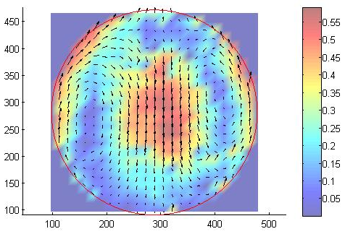
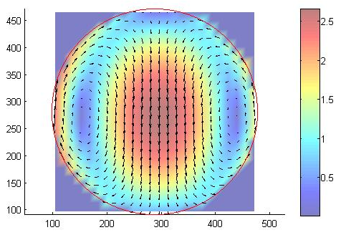
Falling Drop Analysis
The above vector field depicts the average vector field obtained when applying PIV analysis to the capture sinking droplet video.
The above vector field depicts the theoretical vector field for a water droplet sinking through a viscous medium.

Slide 10
PIV Analysis of Collapsing Torus
Shown in the picture on the left, is an example of a torus generated in a viscous medium. The video on the right depicts a collapsing torus, as captured with out PIV system, sped up 10x.

Slide 11
PIV Analysis of Collapsing Torus
The top row is the theory, the bottom row is the experimental.
For each time (t) the left fields are in the lab frame and the right fields are in the shrinking frame.

Slide 12
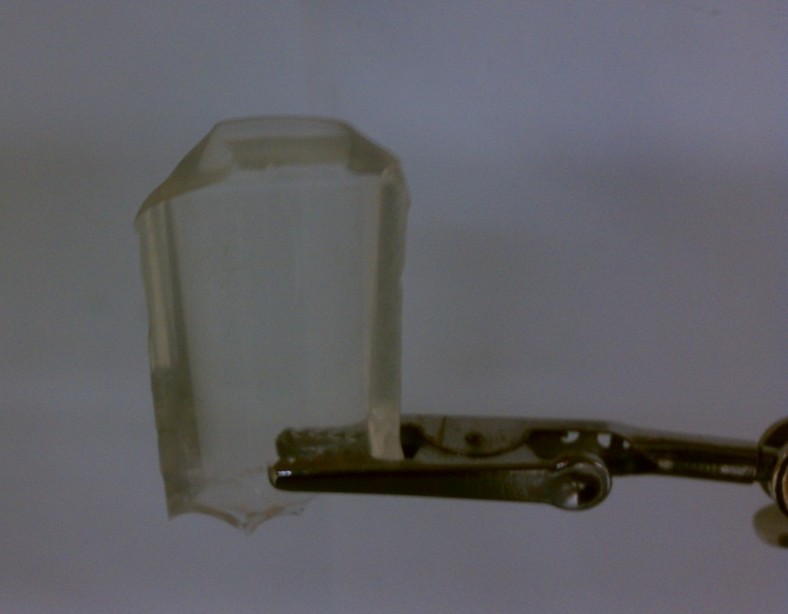
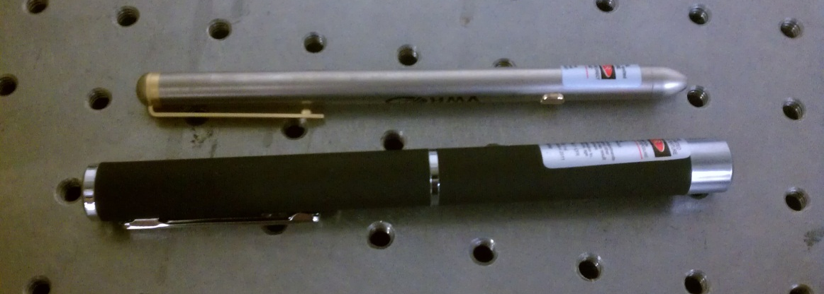
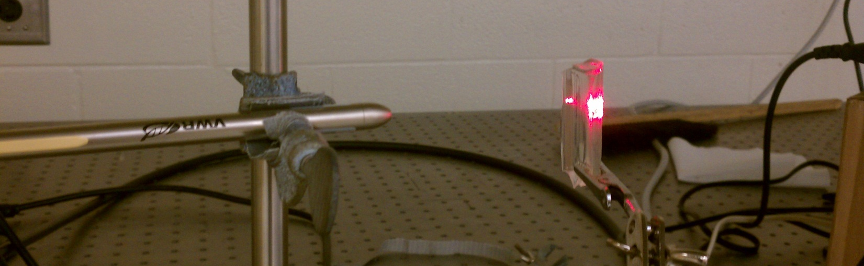
The Laser Sheet Set-Up
Above are the two lasers used for illumination, green (bottom) and red (top).
Above is a close up of the rubber cylindrical lens.
To the left is the rig, set up and in action (shown with the red laser).

Slide 13
Our End Goals
By the end of this project we hope to obtain accurate vector fields of both the horizontal and vertical cross sections of the collapsing torus.
By obtaining such vector fields, we hope to better understand and prove the physical concepts driving the collapse of toroidal droplets.

